Slide 1
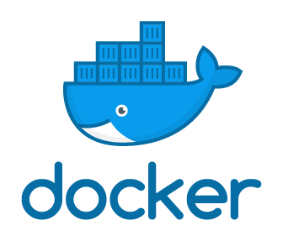
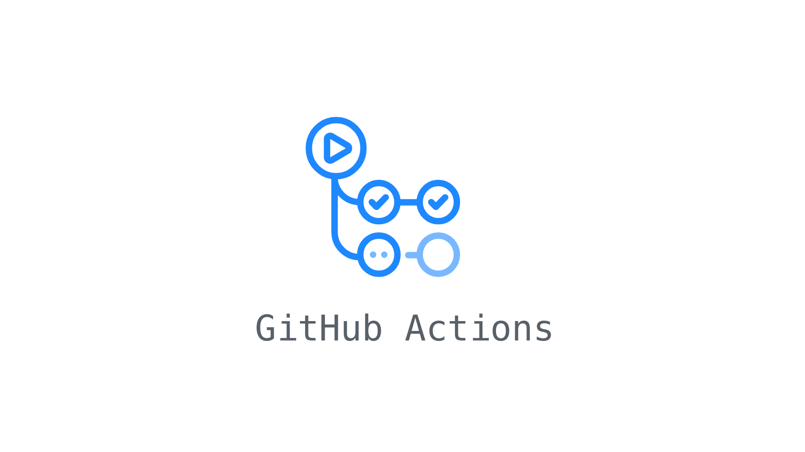
Enhance your pipelines using containers
Sergio Navarro Pino
Tech Lead @AnalyticAlways
@snavarropino

Slide 2
Goals
Understand when we need container in our pipelines
Meet service containers
Meet container jobs
Demos
…
Original presentation: https://github.com/dapr/docs/tree/master/presentations

Slide 3
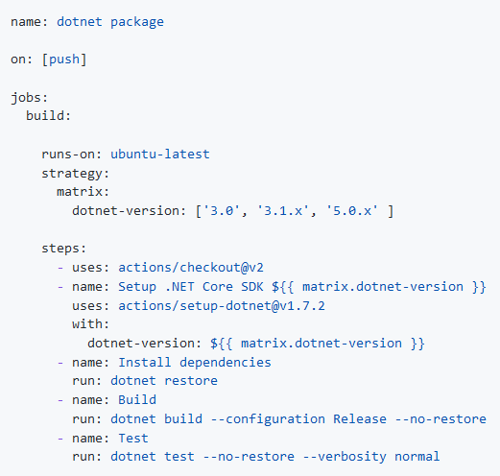
Typical build pipeline

Slide 4
What else?
Integration testing
Secrets scanning
Vulnerability analysis
Performance testing
Contract testing

Slide 5

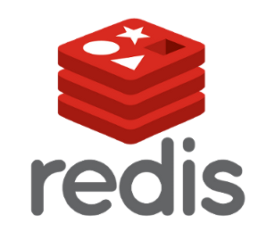



Dependencies

Slide 6

Samurais
Api

Slide 7


DEMO!
Notes:
01-Integration tests

Slide 8
How?
Microsoft hosted agents?
Cross fingers
https://github.com/actions/virtual-environments/blob/main/images/linux/Ubuntu2004-README.md)
Deploy when the pipeline is executed. Slow pipeline!
Self hosted agents?
Deploy on every agent
Collisions between versions
Deploying resources on the cloud?
On the fly? Slow pipeline!
Provisioned? High costs

Slide 9

How?
Service containers
Container jobs

Slide 10


You can start any container you need
Containers run on a docker network
Your entire pipeline can run inside a container

Slide 11
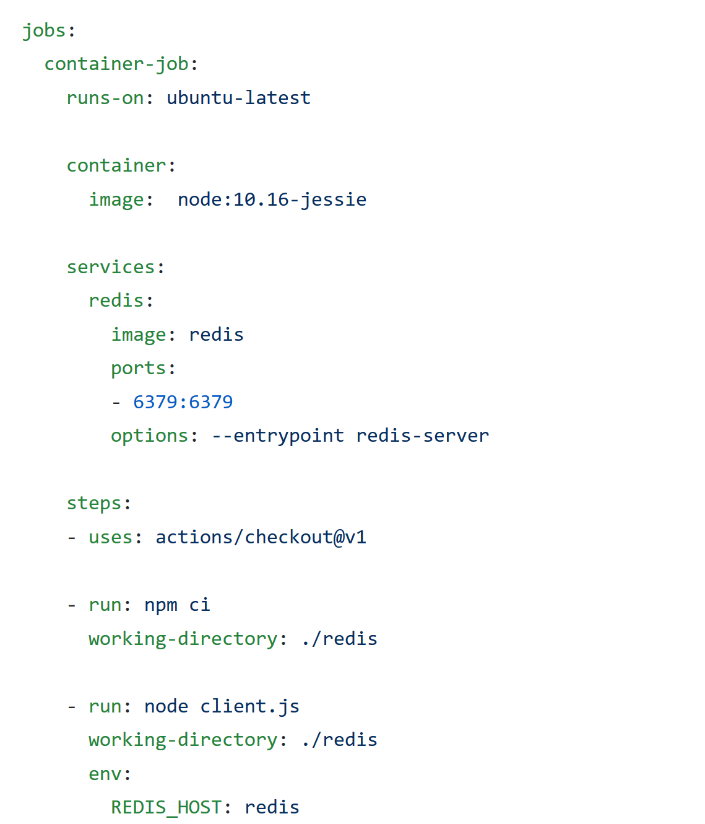

In GitHub actions?

Slide 12

DEMO!
Notes:
02-redis-cli
03-integration-tests-redis
04-container-job-integration-tests-redis

Slide 13
Resources
Github repository with the pipelines and this slides:
https://github.com/snavarropino/enhance-pipelines-containers
Videos & blob posts available at (content in Spanish):
https://www.serginet.com
https://bit.ly/2NwbhLa (youtube channel)
Official documentation
https://docs.github.com/en/actions/using-containerized-services/about-service-containers

Slide 14


